Slide 1
Welcome to Final Year Project (CS402) Presentation
PIXEL GRAPHICS
THICKNESS OF A LINE OR CURVE OF A GIVEN PIXEL
Presenter: Lenz L Nerit
BSCS4-’08

Slide 2
Presentation Overview
Background to Pixel Resolution
How straight lines can be drawn on the matrix of discrete pixels of computer screens.
How can we determine the thickness of line or curve for a given pixel?
Program Demonstration.

Slide 3
Pixel Graphics
What is Pixel?
Pixel is a basic unit of programmable color that can be displayed on a computer or a computer image display.
Every image on the computer is made up of color grid of pixels.
In fact, the computer screens consist of matrix of discrete pixels call raster.

Slide 4
Can we draw directly a straight line or a curve of a given pixel on the raster grid?
Ans: No, it is not possible to draw directly a straight line or a smooth curve from one point to another.
Reason:
  This is because the CRT raster display can be a matrix of discrete pixels each of which can be brightened individually.
However, the lines or curves can be drawn only through the process of approximation by determining which pixels lie close to the desired line or curve
The application of the approximation of the pixels can be best established through some algorithms, which we shall look at next which illustrates the approximation process of determining which pixel to select in a raster grid.

Slide 5
Bresenham’s Line drawing algorithm
The algorithm tries to pick the optimum raster points to form a straight line. It is achieved by incrementing or by one unit depending on the gradient of the line.
The key idea in this algorithm is that, the increase in one of the variables by either zero or one unit is determined by the distance between the actual line location and the nearest grid locations (midpoints) called the error term denoted by £ as illustrated below.

Slide 6
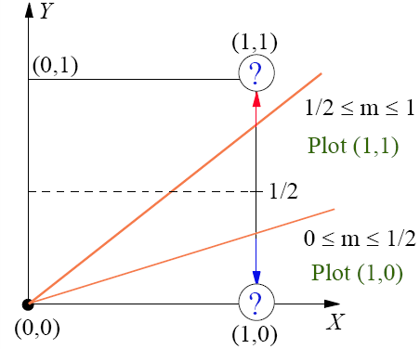
Basis of Bresenham Line drawing algorithm
In the diagram given, if the required line passes through (0,0) has a slope greater than ½ , then intercept x=1 will be closer to the line y=1.Thus the raster point that be best selected will be at point (1,1) rather than the point (1,0).On the contrary, if the slope of the required line is less than ½, then the intercept x=0 will be closer to the point (1,0) which would be chosen as raster point. To illustrate this idea in full detail, let’s draw a line between two end points and that will always draw pixels on the endpoints. Let’s assume that the slope of the line is -1<m<1 and that x1<x2 as given below.

Slide 7
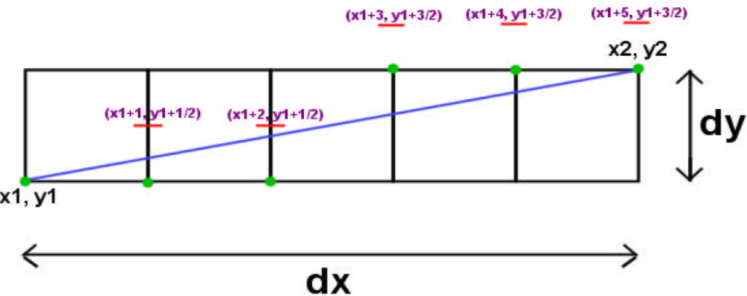
Bresenham’s line drawing algorithm
The is a good representation of how one might choose the pixels to light up. The blue line is the “true” line between the endpoints, but we approximate to the green pixels (dots) based on the relative positions of the blue line and the midpoints.
The pseudo code :
if (Blue Line<Midpoint)
Plot_East_Pixel ()
else
Plot_NothEast_Pixel ()
This is the basis for Bresenham ‘s line drawing algorithm for lines with a thickness of 1 pixel.
*Note that the illustration above is true for the first quadrant .In the other quadrants, necessary adjustments will have to be made.

Slide 8
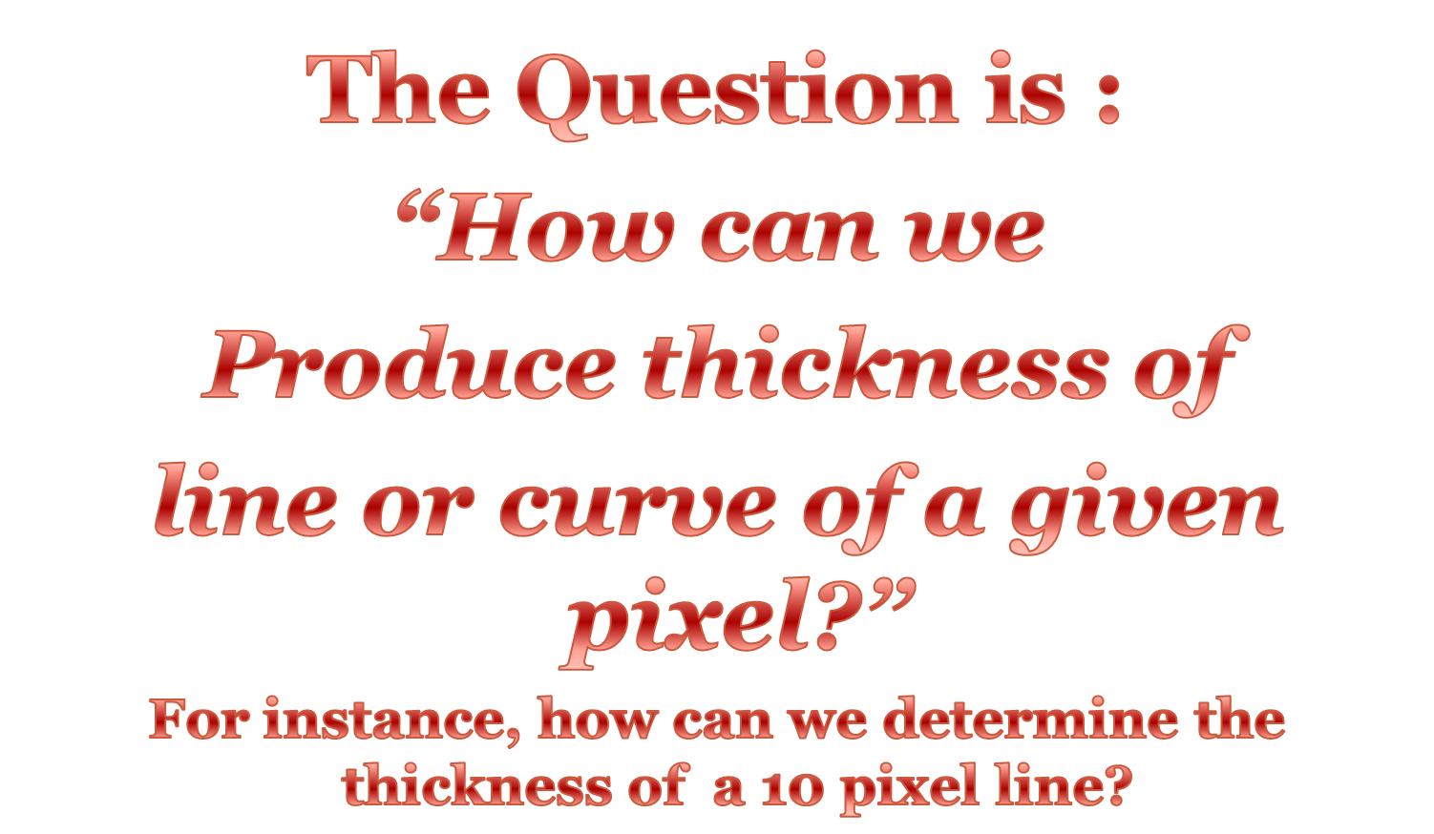
Thickness of Line

Slide 9
Line Thickness
In mathematics, lines do not have thickness.However,they are at least one pixel thick.
Drawings can distil images of objectives into a relatively small number of simple lines.
By varying the thickness of lines and outlines as we draw, we give a flat sheet of paper a meaningful third dimension.

Slide 10
Thickness of lines and Curves
In order to produce a thickened line, a number of single thickness lines can be drawn in parallel. There are two ways of doing this:
  Draw lines perpendicular to the ideal line stepping along it.
  Draw lines parallel to the ideal line and step perpendicularly.
The diagram below illustrates thickness of line produced by drawing parallel line to the ideal line and step perpendicularly.

Slide 11
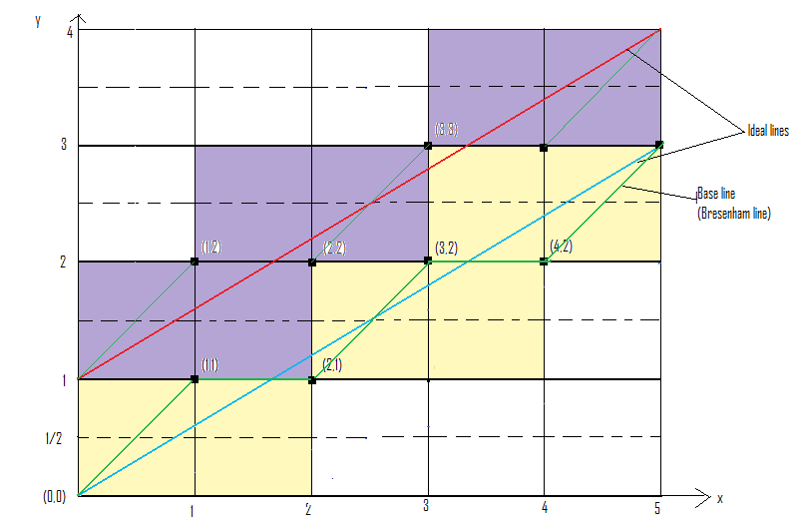
Illustration of determining thickness of line

Slide 12
Application Program
        Code Overview
        Program Demonstration
        Thankyou for your attendance...

